Slide 1
EC544: Gnest Thermostat
Andrew Hoang
Wenpeng Wang
Terry Chan

Slide 2
Mission
Create a system that will continuously measure (0.5 Hz) temperature at five locations in the room, and report these values to a central station.
The central station should report, in alphanumeric form, the most recent temperature values from each thermometer along with the current (spatial) average temperature in the room.

Slide 3
Presenter
 | Andrew Hoang | Wenpeng Wang | Terry Chan
Challenge 1 |  |  | Presenter
Challenge 2
Challenge 3
Challenge 4
Challenge 5
Challenge 6
Challenge 7
Challenge 8

Slide 4
What did we each do in this challenge
 | Andrew Hoang | Wenpeng Wang | Terry Chan
Challenge 1 | Coded all the Node JS side of the challenge, set up the GITHUB | Coded the majority of the Arduino code, figured out the calibration of the sensors | Built the thermistors and set up all the xBees. Added the heart beat code to the arduino script. Finish up ppt presentation

Slide 5
Design Concept
The idea was to link all of the xbees in the same mesh with a coordinator that is linked to the computer and the router xbees are individually linked to an Arduino that measures temperature.
A voltage divider circuit is built around a thermistor and a resistor. The voltage measured is then translated into temperature by using the following code

Slide 6
The router will then send the temperature data to the coordinator.
The data received from the coordinator is then processed in Node JS to calculate the average temperature and show the individual temperature of all sensors

Slide 7
Schematic
Stations
Stations
Stations
Stations
Base
Computer

Slide 8
Schematic of the javascript code
Since the reading from the different sensors come at different times intervals, it’s hard to capture a specific temperature data from individual sensors, so what we have is to have a floating average for each sensor. Therefore the average temperature of the room can be calculated from the floating average of each one of the sensors.

Slide 9
Components
Hardware
4 router xBees
1 coordinator xBee
4 Arduinos for temperature measurements
4 portable chargers to power the Arduinos
Software
XCTU for linking the xBees
Node JS and Atom
Arduino
Github

Slide 10
Challenge and resolve
The first challenge we encountered was the problem between the xBee communications. We set up PAN ID but they are still not responding.
What we did was we found out we not only need to reset the PAN ID but also the Operating PAN ID and Operation Channel

Slide 11

The second challenge was we need to find a way to differentiate the different readings from each sensor
What we did was to create an ID for each Arduino, and the code in Node JS will then pick them up and divide them. The ID is generated randomly from 1 to 300 and this range of random numbers can be changed accordingly to the number of sensors we have.

Slide 12
The third challenge we encountered is to find a way enable the adding and dropping of devices.
We resolved that by adding a ‘heartbeat’ signal to each sensor. If the base doesn’t get a heartbeat from any devices within 30 seconds, then this device is considered dropped.

Slide 13
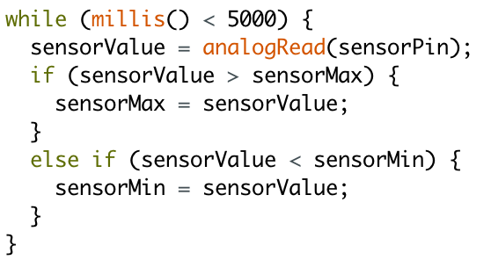

Calibration
Analog read from port
Divide the value from Minimum to Maximum for 1024 stages
Use map function: map(value, in min, in max, out min, out max)
Constrain the output value

Slide 14
Coordinator xBee
Router xBee

Slide 15
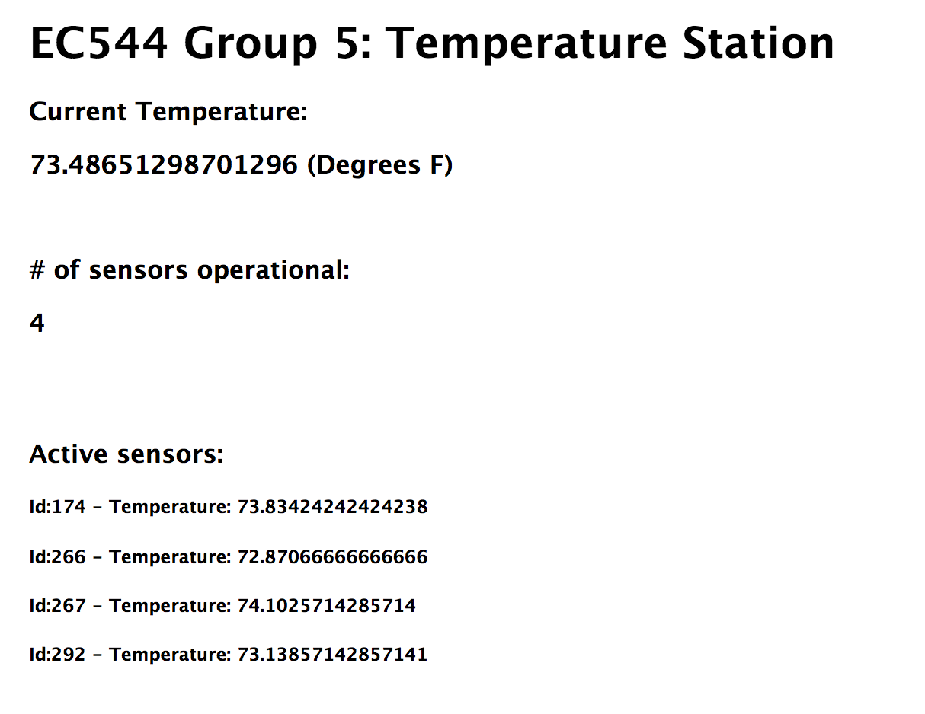
Results

Slide 16
Reference
http://en.wikipedia.org/wiki/Thermistor

